Slide 1
A COMPREHENSIVE ANALYSIS OF FINANCIAL
PERFORMENCE : INSIGHTS FROM A LEADING
BANKS

Slide 2
TEAM ID: NM2023TMID02288
TEAM MEMBERS:
TEAM LEADER : K. VANISRI
TEAM MEMBER : B. SWETHA
TEAM MEMBER : T. SWETHA

Slide 3
INTRODUCTION Financial performance analysis is a multifaceted approach to evaluating a company’s financial performance. It is the process of examining a business enterprises financial records, statements, tools and processes.

Slide 4
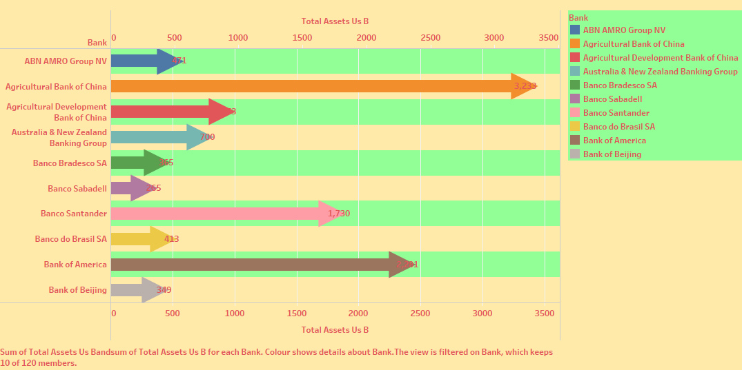
SHEET-1

Slide 5
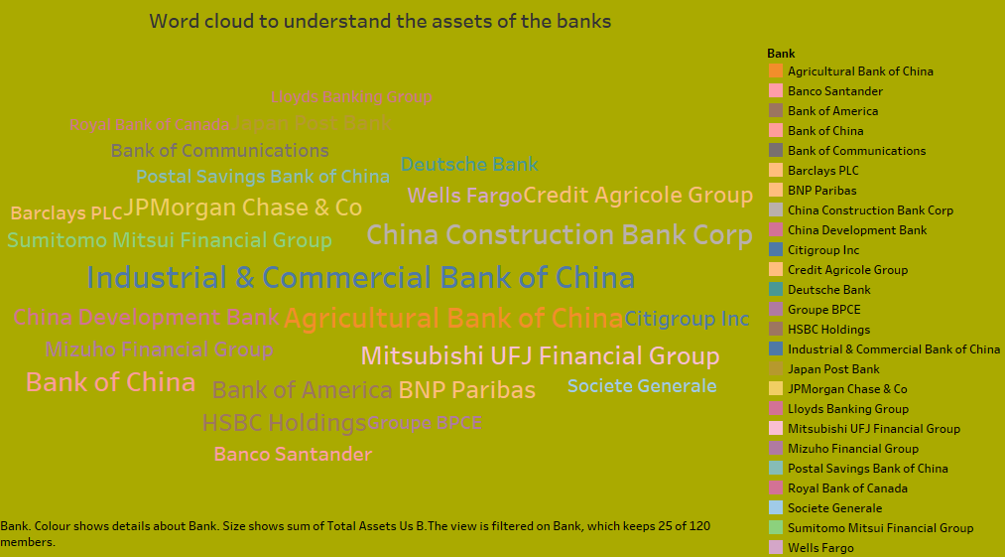
SHEET-2

Slide 6
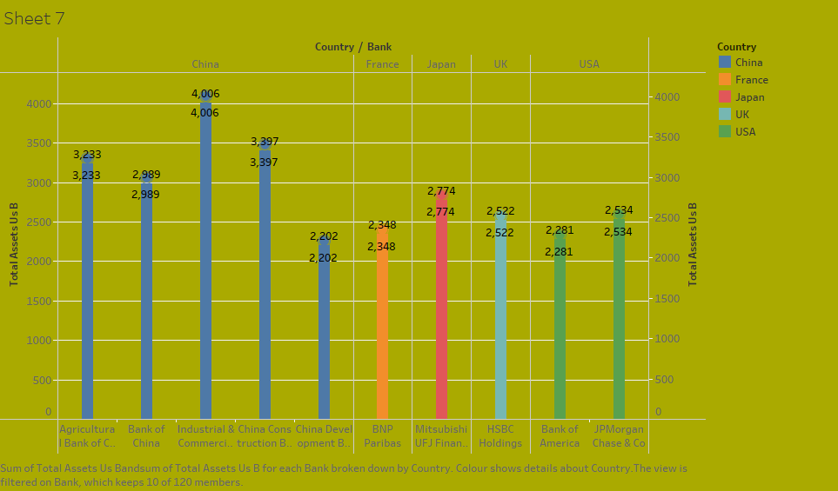
SHEET-3

Slide 7
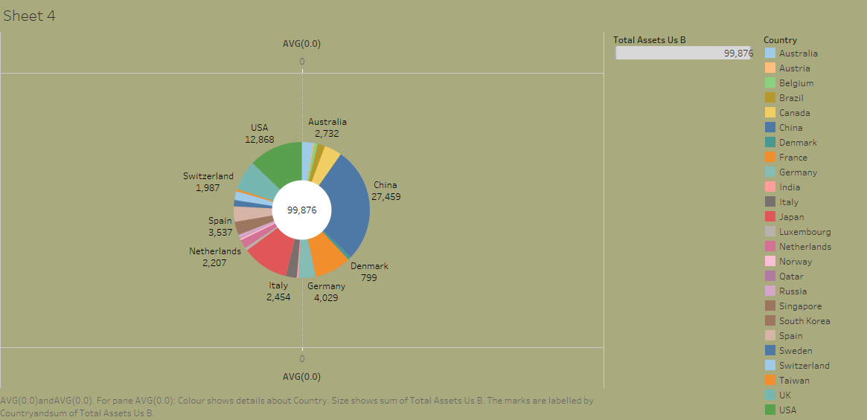
SHEET-4

Slide 8
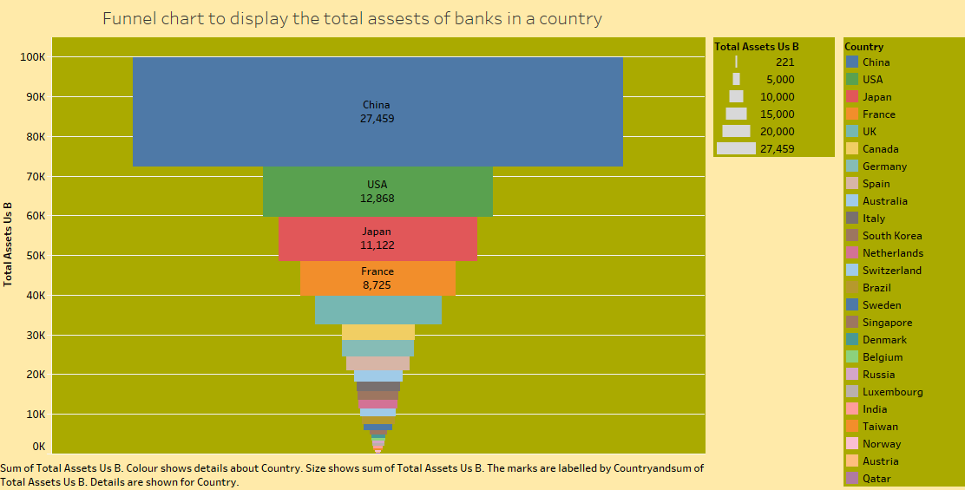
SHEET-5

Slide 9
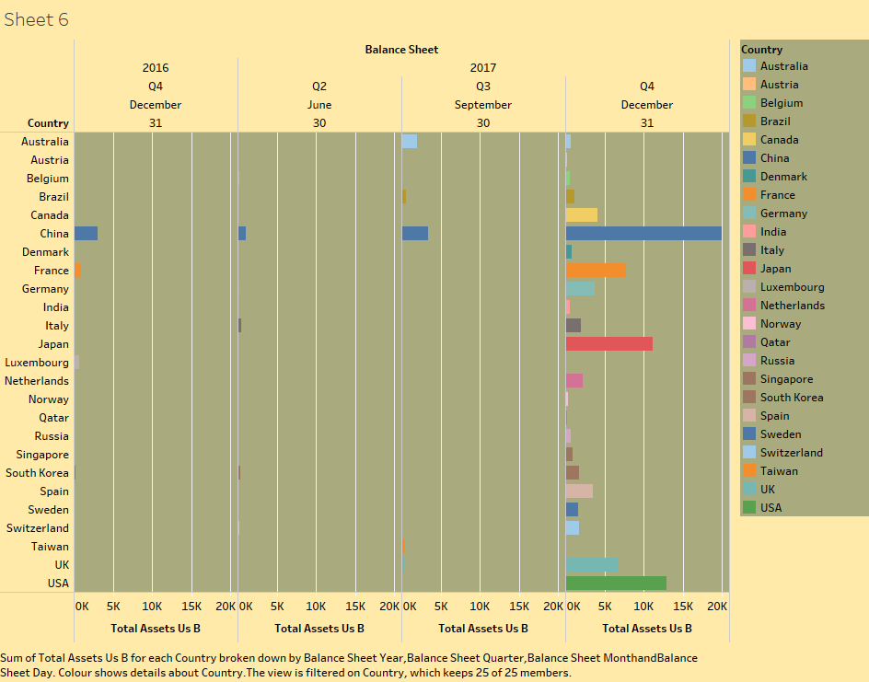

Slide 10
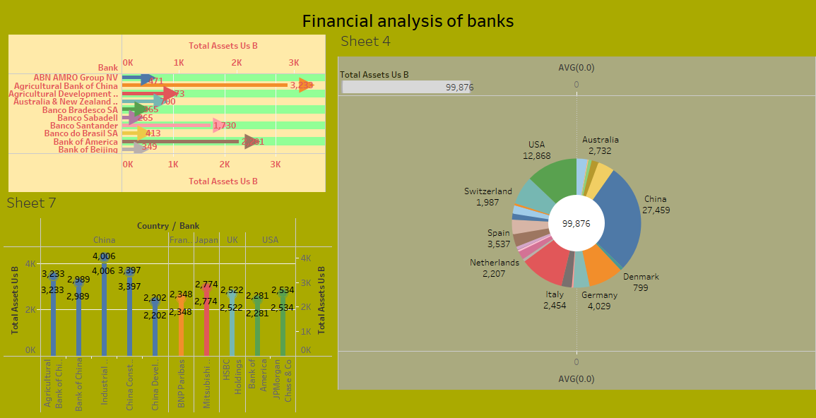
DASHBOARD 1

Slide 11
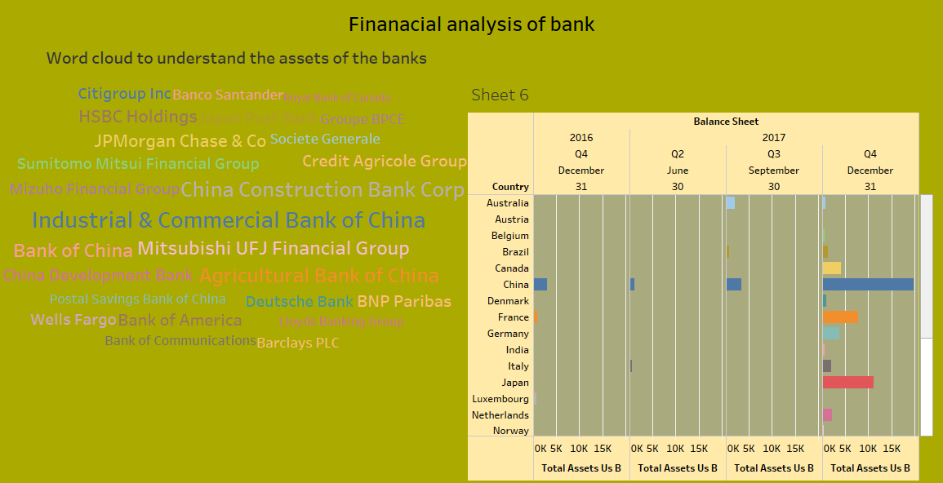
DASHBOARD 2

Slide 12
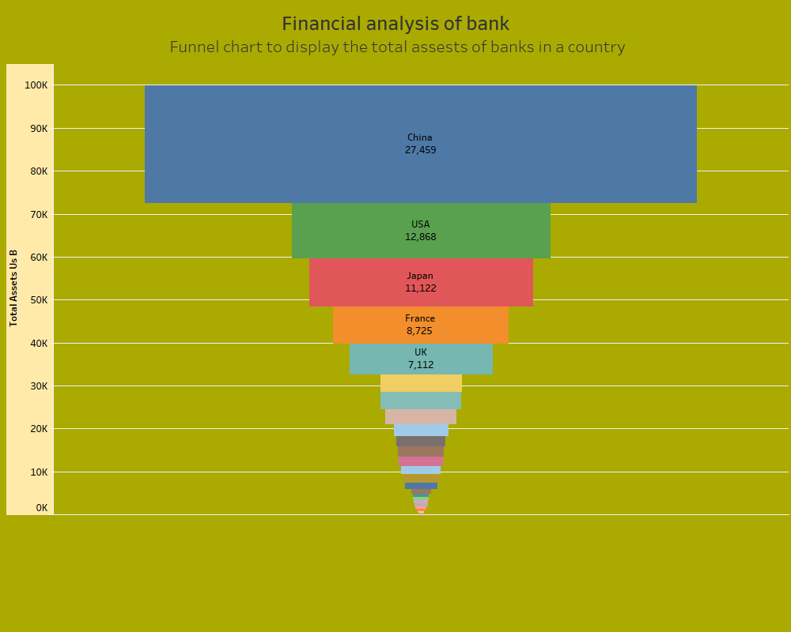
DASHBOARD 3

Slide 13
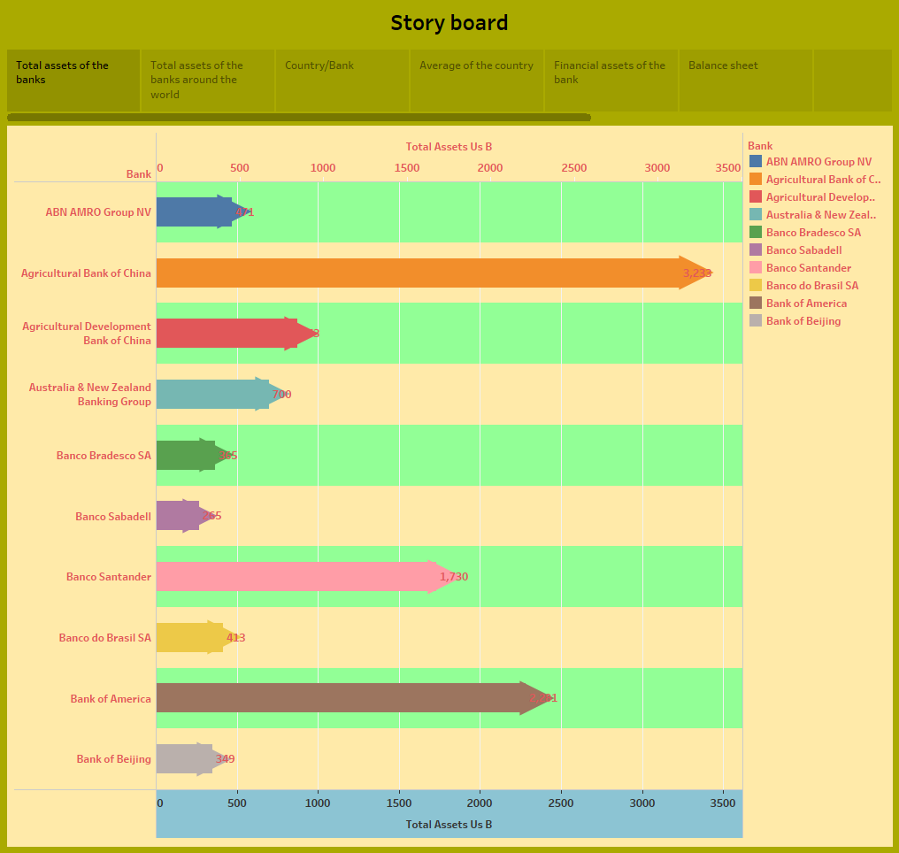
STORY

Slide 14
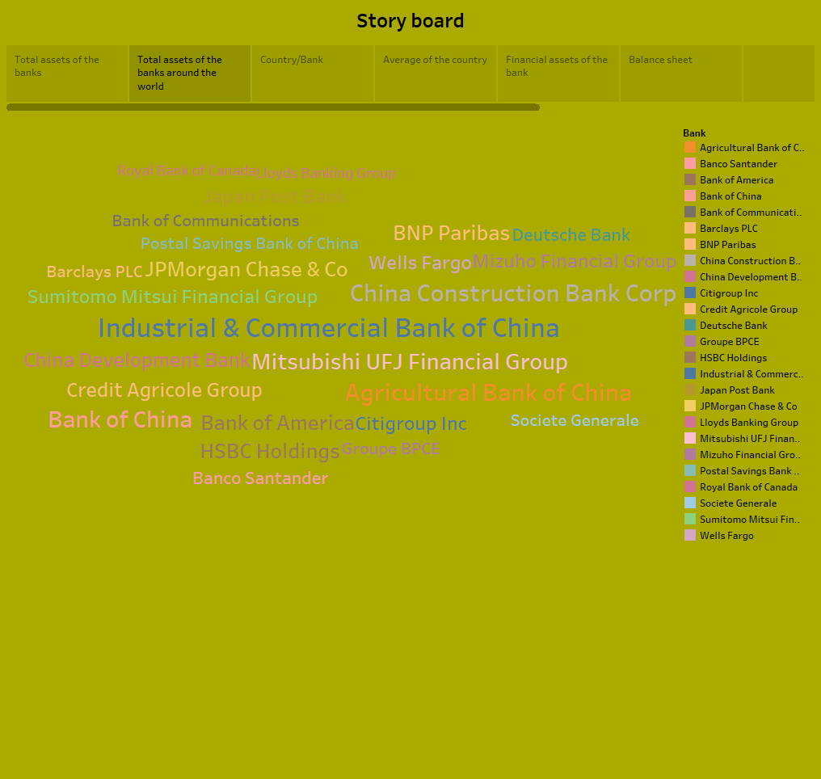

Slide 15
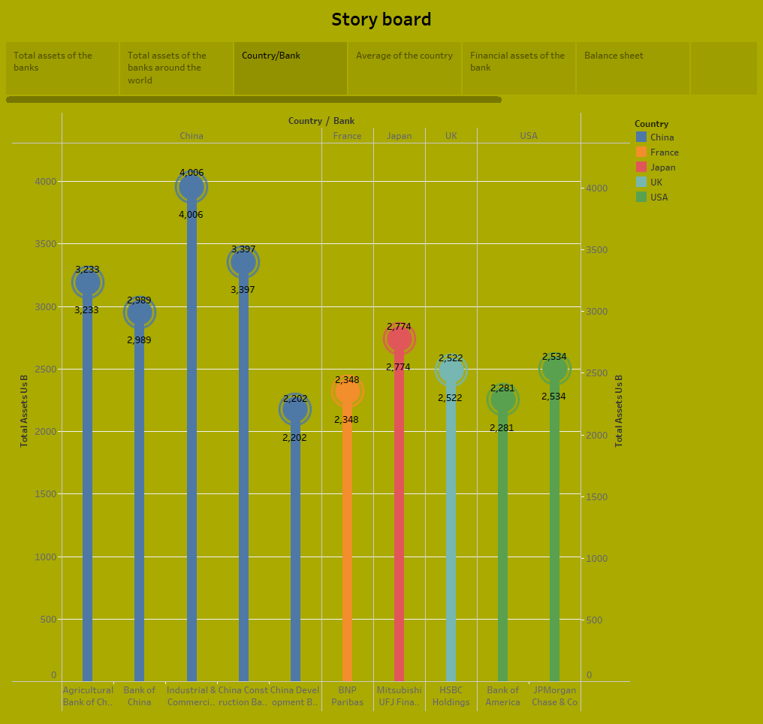

Slide 16
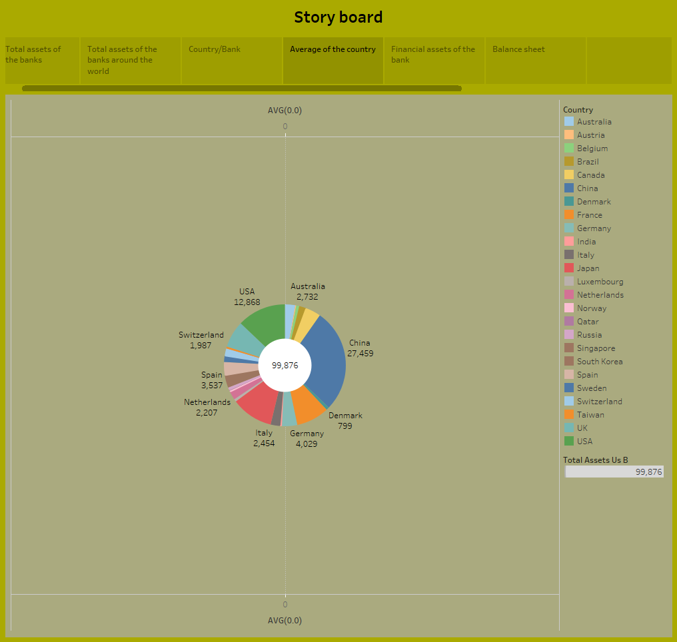

Slide 17
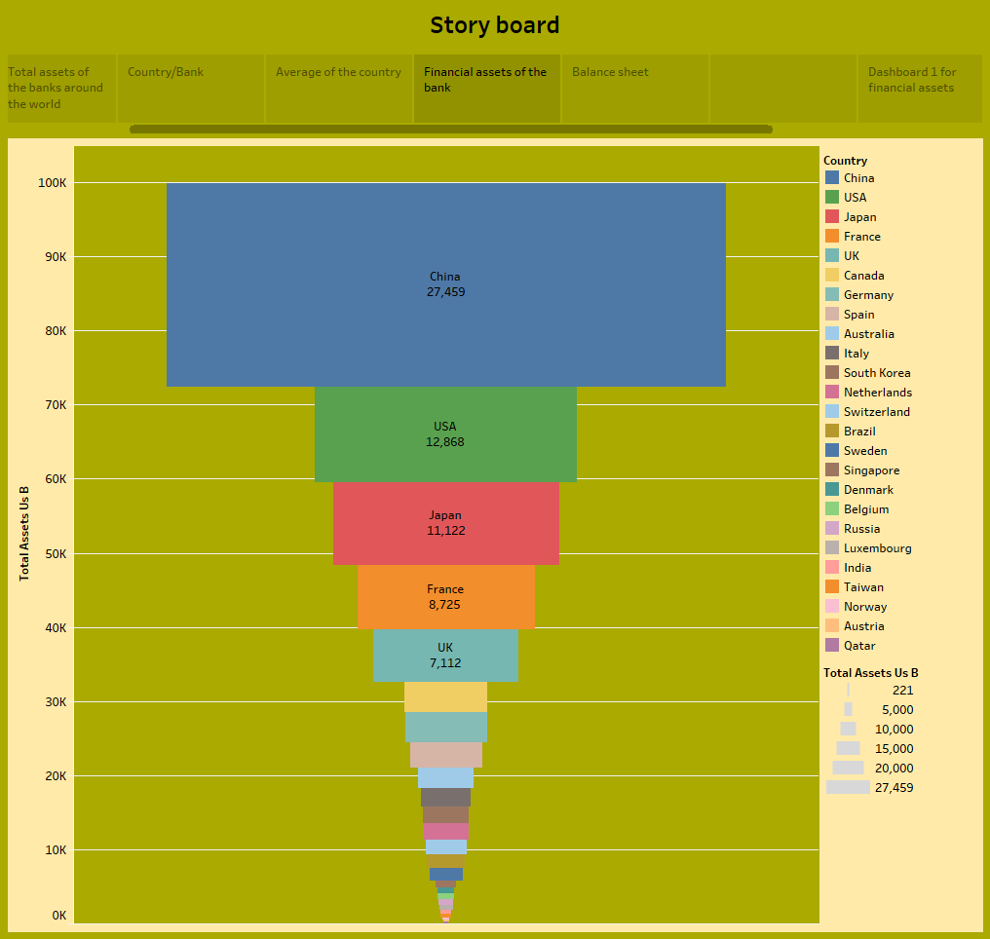

Slide 18
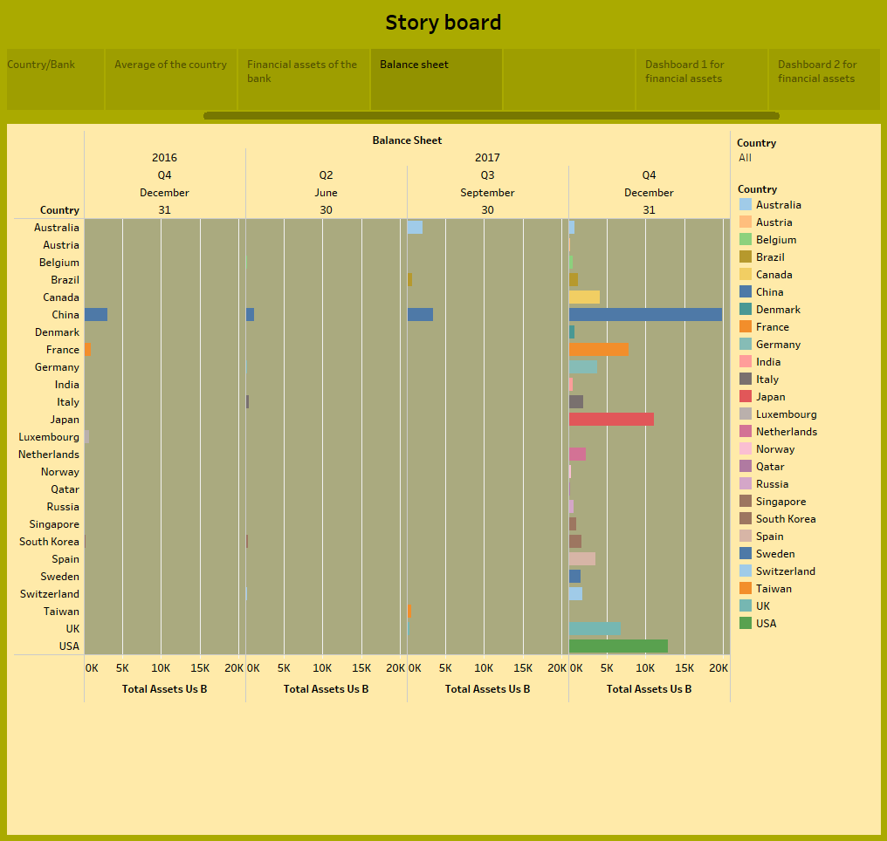

Slide 19
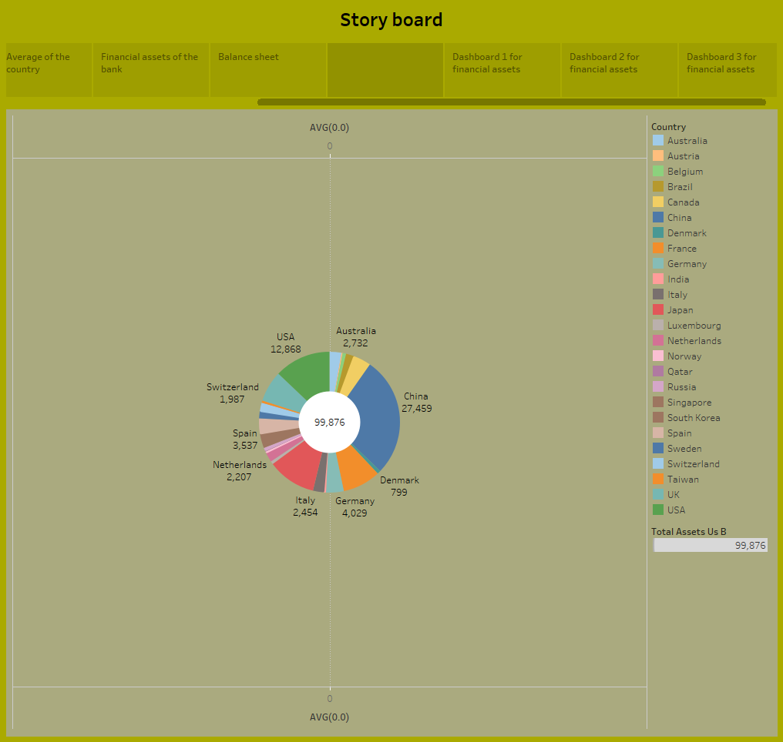

Slide 20
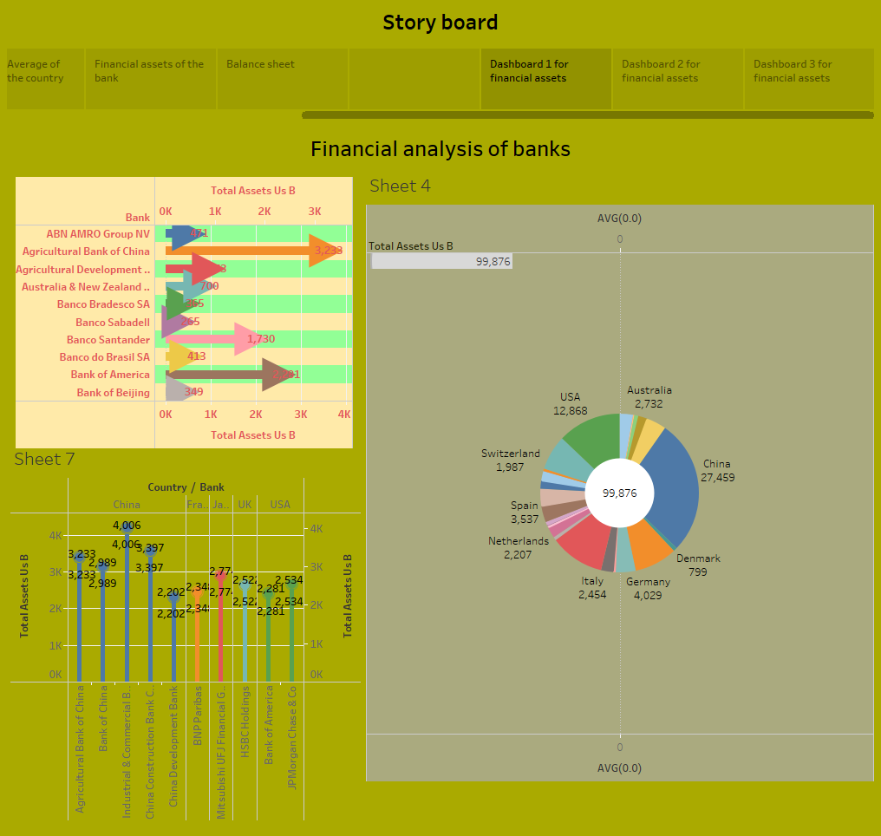

Slide 21
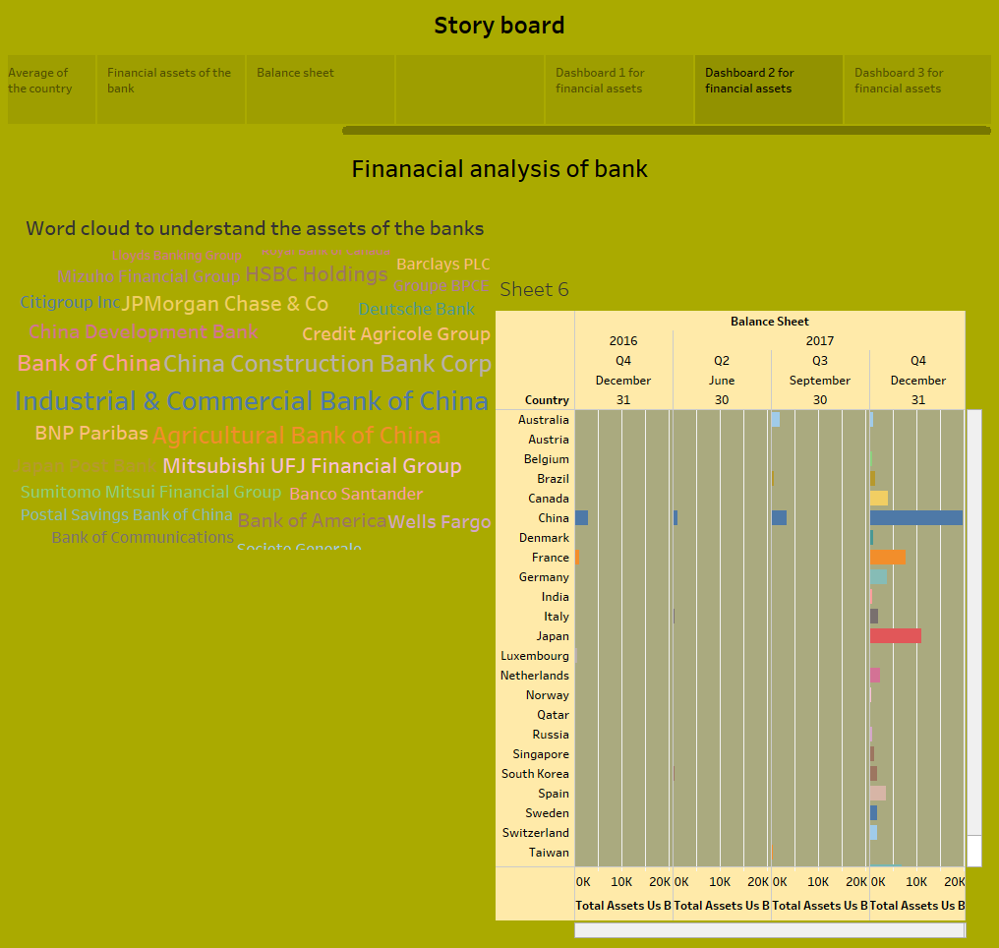

Slide 22
